Slide 1
1. Methodology and universals
ENG 452: Linguistic Typology

Slide 2
Linguistic and Language: Introduction
Linguistics is the scientific study of language.
Since, linguistic is the scientific study of language, it is imperative for a linguist (those who study language) to know what language is.
Language is a complex human phenomenon; all attempts do define it have proved inadequate.
However, some of the most commonly approved definitions of language given by the experts in the field of linguistics are given below:

Slide 3
1. Language is a symbol system based on pure or arbitrary conventions…
infinitely extendable and modifiable according to the changing needs and
conditions of the speakers. (Robins 1985)
This definition states that language is a system of symbols.
Every languages selects some symbols to represent speech sounds.
The English sound /k/ for example has the symbol k for it, in Hindi we have क.
These symbols make up the language’s alphabet and can be used in many ways to create meaningful words.
It also says the system is purely arbitrary, i.e., there is no one to one correspondence between the word and the thing it stands for.
Language is infinitely modifiable and extendable. As the demands of the community using the language change, words continue to take on new meanings and be added to existing ones.

Slide 4
2. Language is a purely human and non-instinctive method of communicating
ideas, emotions and desires by means of a system of voluntarily produced
symbols. (Sapir 1921)
According to this language is human and non-instinctive.
Only humans possess language.
Animals do have a communication system but not a developed system as we have. That is why language is said to be species-specific.
Language does not pass from a parent to a child. In this sense it is non-instinctive.
A child has to acquires language.
He/she learns the language of the society or environment in which he/she is grows up.

Slide 5
3. Language is the institution whereby humans communicate and interact with each
other by means of habitually used oral-auditory arbitrary symbols. (Hall)
The definition rightly says that language is primarily speech produced by oral-auditory symbols.
A speaker makes a series of oral sounds that are transmitted through the air to the speaker.
The speaker then receives the sound waves through his hearing organs and interprets them to the brain, which decodes the symbols to form a meaning.

Slide 6
4. A language is a set (finite or infinite) of sentences, each finite in
length and constructed out of a finite set of elements. (Noam
Chomsky 1957)
Chomsky intended to say: every sentence has a structure.
The human brain is capable of creating different sentences using only a limited subset of the sounds and symbols found in a given language.
A child can create a statement at any moment that has never been expressed or heard before due to the remarkable productivity of the human brain.

Slide 7
Introducing linguistic typology
Linguistic typology / Language typology is a branch of linguistics that started to develop in the second half of the nineteenth century and attempts to categorize languages based on similarities in structure (phonological inventories, grammatical constructions, word order, etc.), not on the genetic level.

Slide 8
What is Linguistic Typology?
Linguistic Typology is the study of the structural features of languages with the goal of classifying them based on their similarities and differences.
It is concerned with patterns across languages, and how languages can be categorized based on these patterns, regardless of their historical or genetic relationships.
Based on their similarities, languages can be divided into smaller groups called language types.
It consists of comparing multiple languages on the basis of shared features.
These features can be lexical, phonological, morphological, syntactic, semantic, etc.
There are many types of features that have been identified and studied by linguistic typologists. Examples include:
the order of the subject, verb, and object in a typical grammatical sentence,
the way the language marks things like number, negation, and case, and the degree to which the language utilizes various kinds of phonemes, such as vowels or nasal consonants.

Slide 9
One of the goals of language typologists is to elucidate (analyze/explain) features that are shared by all languages in the search for universal grammatical attributes.
If two languages share a feature that isn’t universal to all languages, it could be the result of any one of three possible causes:
The shared feature is the result of the languages being genetically related to each other, meaning that they both inherited the feature from a common parent language.
The shared feature spreads from language to language through contact. This is called borrowing or diffusion.
It is coincidental.

Slide 10
Similarities Between Languages
1. Historical Origins: Languages may share similarities if they originate from the same linguistic family or
historical lineage.
2. Language Contact: When languages are in close contact (e.g., due to trade, colonization, or migration),
they may adopt words, grammar structures, or sounds from each other.
3. Shared Environments: Both natural (geography) and cultural environments can influence languages
similarly, leading to shared terms, expressions, or linguistic features.

Slide 11
Differences Between Languages
1. Distinct Origins: Languages with different historical roots naturally diverge in vocabulary, grammar,
and structure.
2. Lack of Contact: Languages that are geographically or culturally isolated may evolve unique linguistic
features.
3. Different Environments: Differences in natural and cultural settings contribute to unique linguistic
expressions and vocabulary.

Slide 12
Linguistic Typology Methodology
The methodology of linguistic typology is inductive-analytic, which means it's an empirical, bottom-up approach to analyzing languages.
Typologist (are inductivist) believe in drawing their generalizations based on data collected from a wide range of languages, (in opposed to deductivists who may arrive at these constraints based on a metalinguistic theory, drawing their evidence from a single language or a limited number of languages).
They argue that “it is necessary to have data from a wide range of languages” (Comrie 1981: 4) to carry out research on language universals or typology.
Typologist uses cross-linguistic comparison to identify patterns and correlations.
They relied on both qualitative and quantitative analysis of languages.
Inductive method: Starts with specific observations and leads to general conclusions.
Deductive method: Starts with general ideas or premises and leads to specific conclusions.
Some studies rely on reference grammars published in dialect atlases and dictionaries,
while others use textual analysis that involves sampling directly from databases of texts featuring the target
languages.

Slide 13
Linguistic Typology Goal
Linguistic typology involves the classification of languages based on their structural features, such as grammar, syntax, and phonology.
It aims to identify and explain the common properties and structural diversity of languages, and to understand the underlying principles of human language. .
To study the similarities and differences among languages that do not stem from shared genetic relationship, language contact, or shared environmental conditions.
The main technique used in linguistic typology research is the comparative method, which involves comparing and contrasting the characteristics of different languages.

Slide 14
Subdisciplines
Phonological typology, syntactic typology, lexical typology, and theoretical typology
Examples
The order of subject, verb, and object in a sentence, how languages mark number, negation, and case, and how languages use phonemes

Slide 15
Classification of Languages
There are two kinds of classification of languages practiced in linguistics: Genetic (or genealogical) and typological.
1. Genetic (or genealogical) classification of language
In linguistics refers to the classification of languages based on their historical and genetic relationships. It is used to group languages into families according to their shared ancestry and origin. In this typology, languages are categorized not by their structural features or functional similarities, but by tracing their development from a common ancestor or protolanguage.
For instance, the Indo-European language family includes languages like English, German, Hindi, and Russian, all of which are thought to have evolved from common proto-language spoken thousands of years ago. Similarly, the Afro-Asiatic language family groups languages like Arabic, Hebrew, and Amharic based on their shared roots.
4 (four) major language families in the world are: Indo-European family, Dravidian language family, Tibeto-Burman language family, and Austroasiatic language family.
Recently, Andamanese is recognized as one of the language families in India.

Slide 16
2. Typological classification
This is a method of classification categorizing languages based on their structural characteristics rather than their historical or genealogical relationships.
This approach focuses on the similarities in grammatical structure, syntax, morphology, and other linguistic features among different languages.
The goal is to group languages into types according to formal criteria that highlight their commonalities.
A typological classification groups languages according to their structural and functional characteristics.
The most famous typological classification is
analytic language (isolated or root -- no inflection!): e.g. Vietnamese, Chinese
synthetic language(inflectional or fusional) ) : e.g. Latin, Russian, Hindi
Agglutinative language: e.g. Turkish, Finnish, Malayalam, Punjabi, Tamil
Also, there is - Synthetic agglutinative: Gujarati, Marathi

Slide 17
Roughly speaking, an isolating language is one in which all the words are morphologically unanalyzable (i.e., in which each word is composed of a single morph); Chinese and, even more strikingly, Vietnamese are highly isolating.
We have example form Mandarin Chinese.
(1) zhangsan-Ø mà lisi-Ø le ma [Mandarin Chinese]
Zhangsan scold Lisi crs q
‘Did Zhangsan scold Lisi?’
(2) rén-Ø lái le
person come crs
‘The person has come.’ (Li and Thompson, 1981:20)

Slide 18
An agglutinating language (Tibeto-Burman languages spoken in northeast India) is one in which the word forms can be segmented into morphs, each of which represents a single grammatical category.
Tibeto-Burman languages are mostly agglutinative in nature.
Each morpheme typically represents one unit of meaning.
An example from Thadou (Tibeto-Burman spoken in Manipur, Northeast India) is given below:
(3) boinú=in hai á=nè=è
boinu=ERG mango 3SG=eat=DECL
‘Boinu is eating a mango.’ (Haokip, M.K., 2014:189).

Slide 19
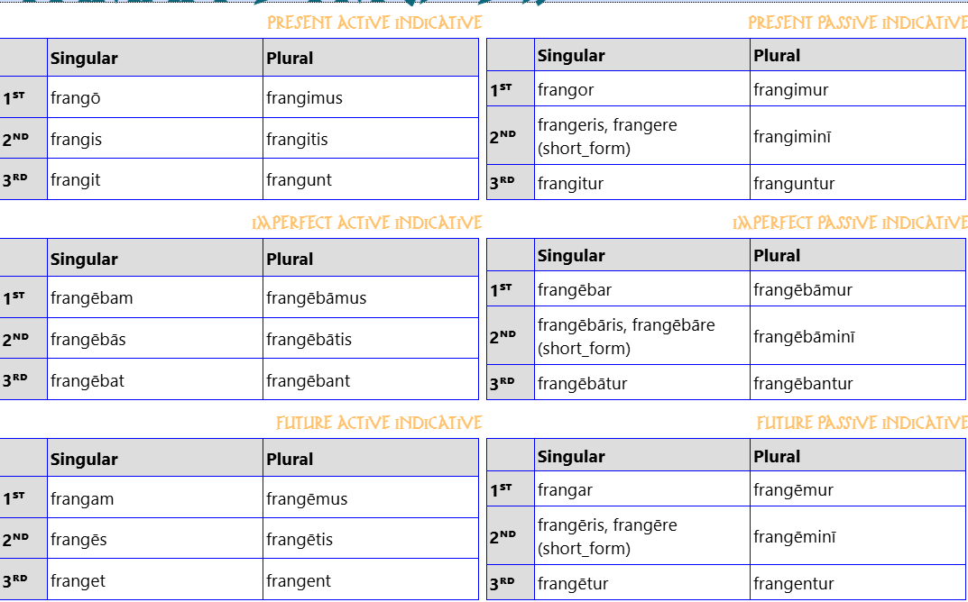
An inflecting (fusional) language is one in which there is no one-to-one correspondence between particular word segments and particular grammatical categories. The older Indo-European languages tend to be inflecting in this sense.
For example, the Latin
In the inflected type of languages (eg. Latin)
one suffix may express different grammatical
categories, for example in Latin,
frango means ‘break’,
where "о" expresses tense (present),
number (singular), person (I), voice (active),
mood (indicative).

Slide 20
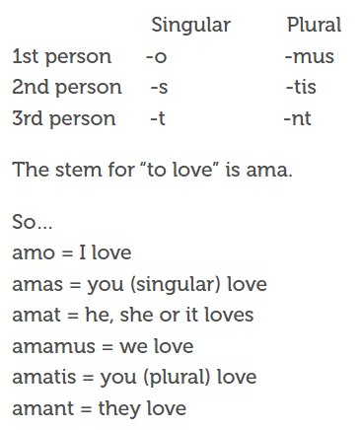
An inflecting (fusional) language is one in which there is no one-to-one correspondence between particular word segments and particular grammatical categories. The older Indo-European languages tend to be inflecting in this sense.
For example, the Latin
homin or homo means ‘man or human’
hominis means ‘of the man’
here the suffix -is represents the combination of categories
“singular” and “genitive” in the word form hominis
“of the man,” but one part of the suffix cannot be assigned
to “singular” and another to “genitive”.

Slide 21
Latin
Master = dominus (in nominative (nom) form)
Sees = videt
Slave = Servus (in nominative (nom) form)
English Latin
The master sees the slave = dominus videt servum
the master.nom sees the slave.acc
‘The master sees the slave.’
The slave sees the master = servus videt dominum
the slave.nom sees the master.acc
‘The slave sees the master.’

Slide 22
What do linguistic typologists study?
There are generally estimated to be around 7000 languages in the world.
This sheer number alone gives one at least a rough idea of the immense diversity of the languages of the world.
A moderate example of this diversity comes from basic word order.
Consider the following six sentences, each exhibiting one of the six basic word orders.
(1) Korean (SOV)
kiho-ka saca-lil cha-ass-ta
Keeho-NOM lion-ACC kick-PST-IND
'Keeho kicked the/a lion.'
(2) Thai (SVO)
khon nii kat maa tua nan
man this bite dog CL that
'This man bit that dog.'

Slide 23
(3) Welsh (VSO)
Lladdodd draig ddyn
killed dragon man
'A dragon killed a man.’
(4) Malagasy (VOS)
manasa ny lamba ny vehivavy
wash the clothes the woman
'The woman is washing the clothes.’
(5) Panare (OVS)
piʔ kokampö unkiʔ
child washes woman
'The woman washes the child.'
(6) Nadeb (OSV)
samũ̀ũ̀y yi qa-wũ̀h
howler-monkey people eat
'People eat howler-monkeys.'

Slide 24
What is most intriguing about these examples is the way the three main expressions - denoting the entity which initiates an action (S), the entity at which that action is directed (O) and the action itself (V) - occur in all six logically possible permutations, i.e. SOV, SVO, VSO, VOS, OVS and OSV.
However, there is a preponderance of SOV and SVO over others in the languages of the world.
Despite the differences among them there must be certain properties whereby the languages of the world are all recognized as falling into the category of human languages. There must, therefore, be an underlying unity to human languages.
There are linguists who are concerned directly with discovering this unity by studying the rich structural variation found in the languages of the world. These linguists are known as linguistic typologists, or typologists for short.
Their investigation of cross-linguistic variation is referred to as linguistic typology, or typology for short.

Slide 25
Typology of language universals
What is language universals?
Language universals refers to properties that are shared by all languages or potentially true for all known languages.
In linguistic typology, however, whatever statistically significant patterns or tendencies that are found in the languages of the world are also referred to as language universals.
It can be in the word order or grammatical categories, phonology, morphology, syntax, etc.
Language universals are statements of fundamental properties of language. They are empirical claims. To say that they are empirical is to say that they are descriptions of patterns found in observed language data. As such, their accuracy can be tested by applying them to previously unstudied languages.
Some Universal rules
1. All languages have at least first-person and second-person pronouns.
2. If a language has singular and dual forms, then it will also have plural forms.
3. If a language has singular, dual, and trial forms, then it will also have plural forms.
4. If a language makes an inclusive/exclusive distinction in its pronoun system, it will make it in the first person.

Slide 26
Some more universals:
1. All human cultures have a language and use it to communicate.
2. All human languages change over time, a reflection of the fact that all cultures are also constantly
changing.
3. All languages are systematic, rule-driven, and equally complex overall, and equally capable of expressing
any idea that the speaker wishes to convey. There are no primitive languages.
4. All languages are symbolic systems.
5. All languages have a basic word order of elements, like subject, verb, and object, with variations.
6. All languages have similar basic grammatical categories such as nouns and verbs.
7. Every spoken language is made up of discrete sounds that can be categorized as vowels or consonants.
8. The underlying structure of all languages is characterized by the feature duality of patterning, which
permits any speaker to utter any message they need or wish to convey, and any speaker of the same
language to understand the message.

Slide 27
Hence, language universals can themselves be classified into four different types, by using two parameters:
(i) absolute vs. non-absolute; and
(ii) implicational vs. non-implicational.

Slide 28
(i) Absolute universals vs. non-absolute (Statistical) universals
Absolute universals hold true of all languages. The following are examples:
(1) a. All languages have consonants and vowels. (= All languages have X, unrestricted)
b. All languages make a distinction between nouns and verbs.
c. All languages have personal pronouns.
d. All languages have ways to form questions.
Absolute universals are assumed to be true of all languages at all times, even for the hundreds of languages for which there is no written description and for many hundreds of others that have become extinct without leaving behind any record.
Non-absolute universals admit exceptions. They are properties of languages that usually hold true. Although they cannot be regarded as reflecting properties that are essential to all languages, they represent significant tendencies. How significant the tendencies actually are depending on the number of exceptions to the universal. In (2), several non-absolute universals are provided.
(2) a. Most languages have the vowel [i]
b. Most languages have adjectives.
c. Some languages have X. (existential statement)
All the statements in (2) have a high degree of probability. (2a), for example, is true of over 90% of languages (Maddieson 1984).

Slide 29
Implicational Universals vs non-implicational
Besides varying in whether they are absolute, statements of universals can be either implicational or non-implicational.
An implicational universal has a precondition. That is, it can be placed in an "if X then Y' form. Examples of implicational universals are given in (3).
(3) a. Greenberg's Universal 4: With overwhelmingly greater than chance frequency, languages with
normal SOV order are postpositional.
b. Greenberg's Universal 3: Languages with dominant VSO order are always prepositional.
So far, the universals we have looked at have all been in a simple form. It is possible, however, to have complex implicational universals as well. In complex statements, there are two (or more) preconditions, as shown in the following:
(4) Greenberg's Universal 5: If a language has dominant SOV order and the genitive follows
the governing noun, then the adjective likewise follows the noun.
The claim in (5) takes the form, "If X, then if Y, then Z.”

Slide 30
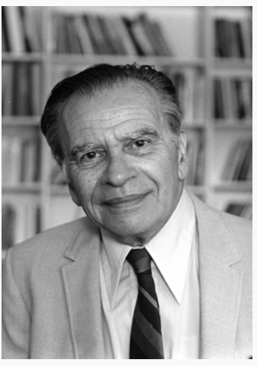
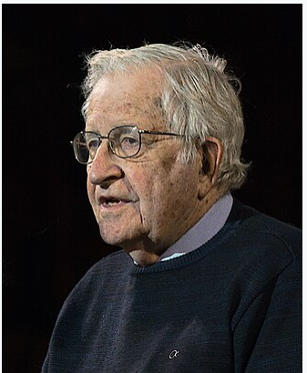
Joseph Harold Greenberg
(1915 – 2001)
was an American linguist, known mainly for his work
concerning linguistic typology and the genetic classification
of languages
He proposed 45 linguistic universals
Noam Chomsky (1928 – )
an American linguist
He is a generativist
He proposed language is an innate and universal human property
He says all human beings are born with an innate ability to acquire language
He says we are endowed with the ability to acquire language
He proposed language acquisition device (LAD)

Slide 31
Non-implicational universals are linguistic universals that state the existence of a particular feature in a language without reference to any other property. They are independent of any other property of the language. For example, the non-implicational universal that all languages have oral vowels is independent of whether the language has consonants.
Some universals are stated without the need of any references to any other properties of the different languages. They do not require another property of the language in order to be existent as a universal. For example, the fact that all languages have nouns, verbs and objects and these would be used to form a sentence in some order is a non-implicational universal and it stands as a statement which has its truth value without any need of some other state to be realized.

Slide 32
Typology, universals and generative grammar
Greenberg’s approach to language universals emerged at about the same time as Chomsky’s, in the late 1950s. The conception of language universals in typology and generative grammar is quite different. We will briefly describe the emergence of Greenberg’s and Chomsky’s ideas, and the similarities and differences that are found in the two approaches to language.
Language universals reflect the belief that there exist linguistic properties beyond the essential definitional properties of language that hold for all languages.
To a considerable degree, the difference between the generative and typological approaches to language universals can be traced to the different traditions to which Chomsky and Greenberg responded. The generative approach represents a reaction against behavioristic psychology, while the typological approach represents a reaction against anthropological relativism.
The behaviorist view of language (B.F. Skinner was a prominent American psychologist) is that language is a set of learned behaviors. Through continuous conditioning and reinforcement, children form associations between environmental stimuli and vocal responses. Words and sentences become habitual behaviors that children reproduce when the appropriate stimuli are present. There is no innate ability or universal internal mental abilities to acquire language.
In contrast, the generative approach (Chomsky) posits the existence of innate internal linguistic abilities and constraints that play a major role in the acquisition of language.

Slide 33
The argument used by Chomsky (e.g. Chomsky 1976) for the existence of innate universal linguistic competence refers to the ‘poverty of the stimulus’. It is argued that the child has an extremely limited input stimulus, that is, the utterances that it is exposed to from the mother and other caregivers. This stimulus is incapable of permitting the child to construct the grammar of the adult’s language in a classic behaviorist model; therefore, the child must bring innate universals of grammatical competence to bear on language acquisition. Hence, the primary focus on universals in the generative tradition has been on their innate character.
Chomsky also brings in Universal Grammar (UG) is a theoretical concept proposed by Noam Chomsky (not without criticism or controversy from scholars in the scientific community) that the human brain contains an innate mental grammar that helps humans acquire language.
Chomsky theorized that the brain contains a mechanism he referred to as a language acquisition device (LAD), which is “separate from other faculties of cognitive activity….Input is needed, but only to ‘trigger’ the operation of the language acquisition device” (Ellis 32).
Without this LAD, according to Chomsky, children would never be able to learn language from the input they receive.

Slide 34
The anthropological relativist view of language is that the languages of the world can vary arbitrarily (randomly): ‘languages could differ from each other without limit and in unpredictable ways’. This view of language was particularly strong among anthropological linguists studying North American Indian languages, which indeed differ radically in many ways from so called Standard Average European languages. However, the comparison of one ‘exotic’ language or a limited number of languages to English only indicates diversity, not the range of variation, let alone limits thereto. Greenberg and others discovered that a more systematic sampling of a substantial number of languages reveals not only the range of variation but constraints on that variation. Those constraints demonstrate that languages do not vary infinitely, and the constraints represent linguistic universals. Hence, the primary focus on universals in the typological tradition has been on their cross-linguistic validity, and on universals that restrict possible language variation.
The innate universals posited by generative grammar are intended to explain linguistic structure. The poverty of the stimulus argument is essentially a deductive argument from first principles (although it does make assumptions about the nature of the empirical input, and what counts as relevant input). The poverty of the stimulus argument is one aspect of Chomsky’s more generally rationalist approach to language.
The universals posited by typology are intended to represent inductive generalizations across languages, in keeping with typology’s empiricist approach to language.

Slide 35
The generative grammarian argues that the discovery of innate principles that the child brings to bear in learning a single language can be extrapolated to language in general (Chomsky 1981).
The typologist argues that a grammatical analysis based on one language or a small number of languages will not suffice to reveal linguistic universals; only a systematic empirical survey can do so.
These differences in approach have led to claims that the Greenbergian approach and the Chomskyan approach to language universals and linguistic explanation are diametrically opposed to each other.
In fact, there are significant similarities between the generative and (functional—)typological approaches.
Both approaches begin with the analysis of language structure.
Both approaches consider the central question of linguistics to be ‘What is a possible human language?’.
Both approaches are universalist, in contrast to their predecessors. There is broad agreement that there do exist a substantial number of universals that hold of all languages.
In fact, for both generative and typological approaches, the foundations of linguistic explanation are ultimately biological, although for the Chomskyan the biological basis is found in genetics (innate linguistic knowledge) and for the Greenbergian the biological basis is indirect, and is to be found in evolutionary theory.

Slide 36
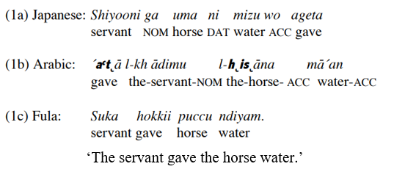
What do languages of the world have in common
and How do they differ from each other?
The fact that languages are both different and similar is a puzzle. Two questions arise:
(1) (a) How are languages different from each other and how are they similar?
(b) What is the reason for their differences and for their similarities?
Languages in different parts of the world are extremely different.
When Japanese is compared to Arabic and to the West-African language Fula,
Example: ‘The servant gave the horse water.’

Slide 37
The differences between the three languages are
(i) The pronunciation of each word differs from one language to another.
(ii) Word order is different.
Japanese is (SOV) Subject – Indirect Object – Direct Object – Verb
Arabic is (VSO) Verb – Subject – Indirect Object – Direct Object
Fula is (SVO) Subject –Verb – Indirect Object – Direct Object
(iii) Case particles are different is Japanese and Arabic.
But Fula (spoken in West and Central Africa) has neither case particles nor case forms.
(iv ) Many more differences that are not clear from the above.
Their Similarities
(i) All three languages have sentences that consist of words with a pronunciation and a meaning.
(ii) In all three languages, the pronunciation may be analyzed into vowels and consonants that combined into
syllables.
(iii) In all three languages, the action of giving is referred to with a verb, while the servant, the horse and the water
are referred to with nouns.

Slide 38
Some abbreviations used in linguistics (used in this slide)
CRS = currently relevant state
Q = Question marker
ERG = Ergative marker
3SG = 3 person singular
DECL = Declarative marker
NOM = Nominative marker
ACC = Accusative marker
DAT = Dative marker
PST = Past tense marker
IND = Indicative marker
IND = Classifier marker
Symbol
Ø = null (means no marker, marker is morphologically not present)

Slide 39
References
Croft, William. 2003. Typology and universals (second edition). Cambridge: Cambridge University Press.
Song, Jae Jung. 2001. Linguistic typology: morphology and syntax. Harlow: Longman.
Whaley, Lindsay J. 1996. Introduction to typology: the unity and diversity of language.
London: Sage.
Syal Pushpinder & Jindal, D.V. (2023). An Introduction to Linguistics: Language,
Grammar and Semantics, Second Edition. PHI Learning Private Limited.
Varshney, Radhey L (2023). An Introductory Text Book of Linguistics & Phonetics.
Surjeet Publications.
https://www.britannica.com/science/linguistics/Language-classification
*Did not repeat some references already mentioned in the slide itself.

